Slide 1
Dynamic Hand Gesture Recognition Based on Deep Learning
Dynamic Hand Gesture Recognition Based on Short-term sampling neural network
Wenjin Zhang
Supervisor: Jiacun Wang

Slide 2
Table of Content
Introduction
Background knowledge
Short-term sample neural network
Experiment
Conclusion

Slide 3
Introduction
This research topic: hand gesture recognition
Based on the current action recognition approach, this study propose a new neural network, Short-term Sampling Neural Network for hand gesture recognition
Test this new approach in the Jester dataset
Test the robustness of this new approach by zooming the Jester dataset.
Discuss the future work about this study.

Slide 4
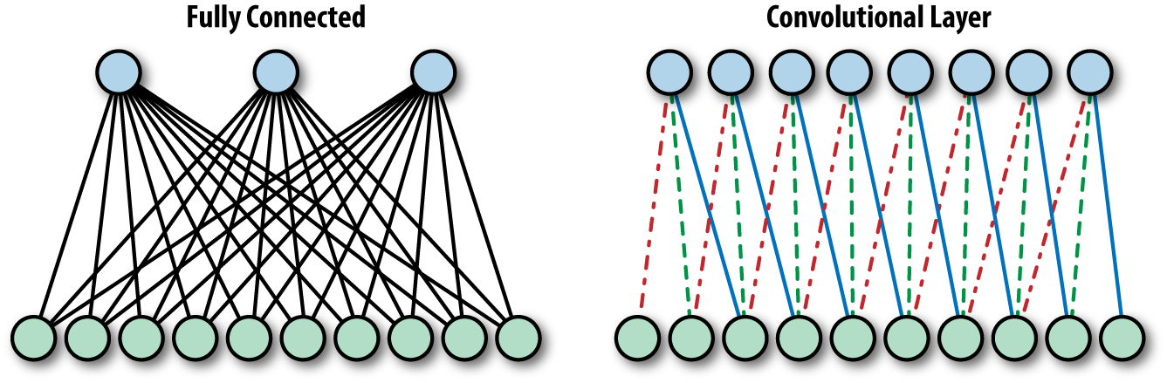
2. Background knowledge
Convolutional neural network
A variant of fully connected neural network；
It supports deeper network because less computation cost and fewer parameters.
Best choice for computer vision

Slide 5

2. Background knowledge
Transfer learning
It still cost a long time to train a CNN network because nowadays the CNN models are designed very deep in order to achieve a great performance like VGG 16, VGG 19, Inception V2, Inception V3；
Transfer learning can apply the trained model to work on other same area.

Slide 6
2. Background knowledge
Action recognition
Hand gesture recognition is a branch of action recognition.
The action recognition approach could be applied to hand gesture recognition.
Two types of solutions about action recognition: single stream network & two stream network.
The major difference between them is the design choice about combining spatiotemporal information.

Slide 7
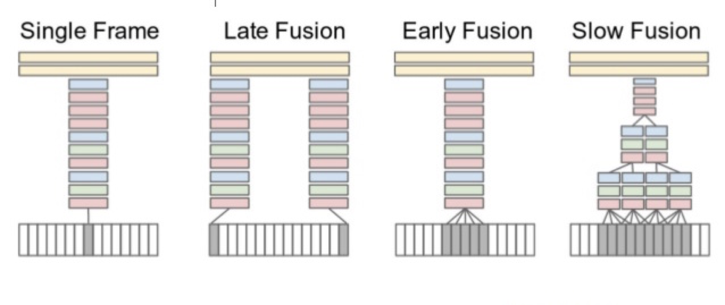
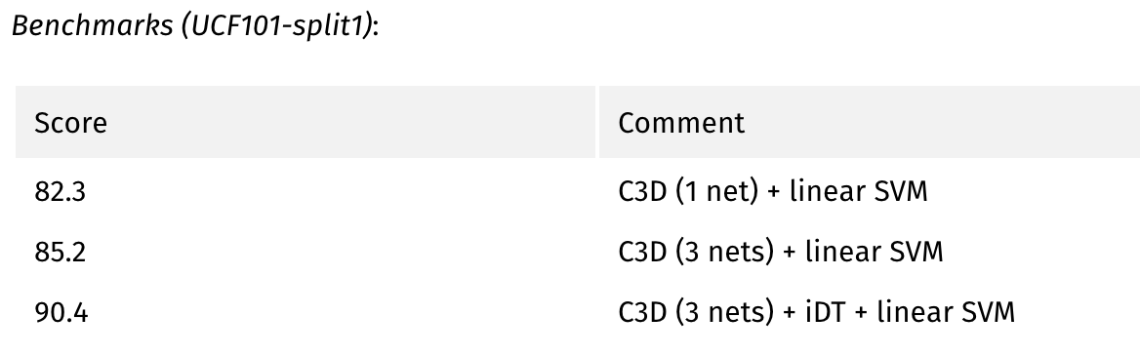
2. Background knowledge
single stream network: try to predict by stacked original frames
3D CNN is a good practice, but it introduce two much computation cost.
Notes:
Although the author who proposed this idea didn’t get great performance in his experiment, the follower used the 3d convolutional neural network to implement this idea and achieved a great idea.

Slide 8
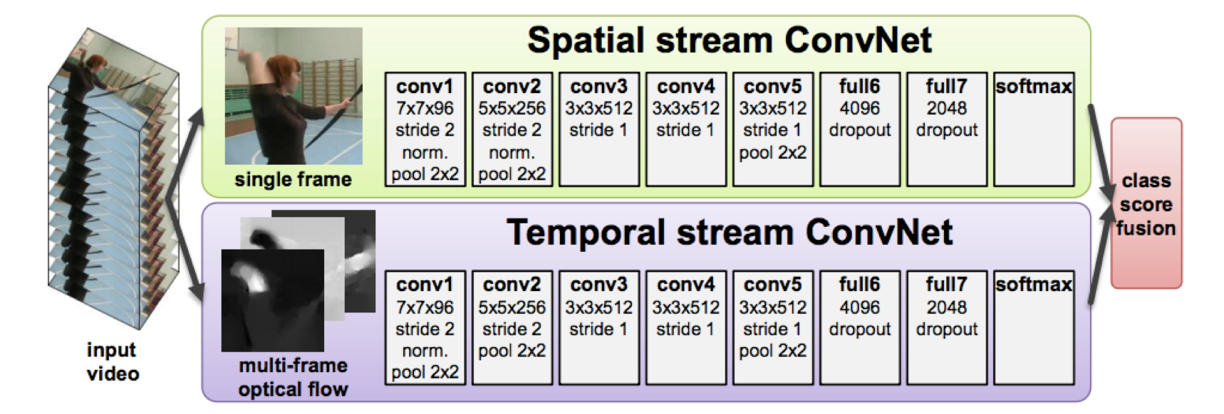
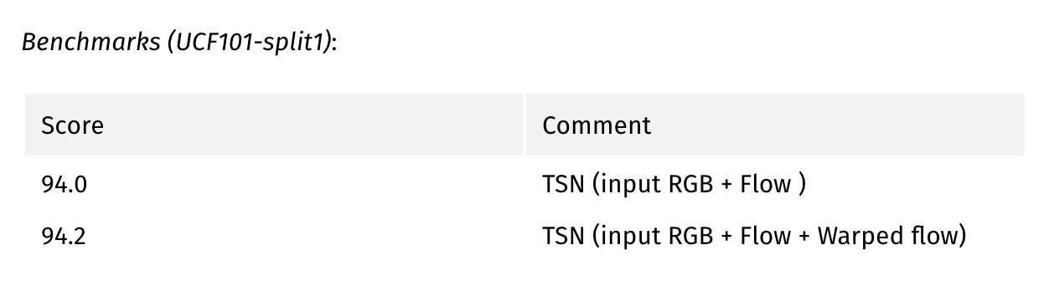
2. Background knowledge
Two stream network: try to predict by stacked original frames and optical flow frames
Better than single steam network, but it cost extra computation for optical flow
Current great approach are all based on two stream network, like TSN;

Slide 9
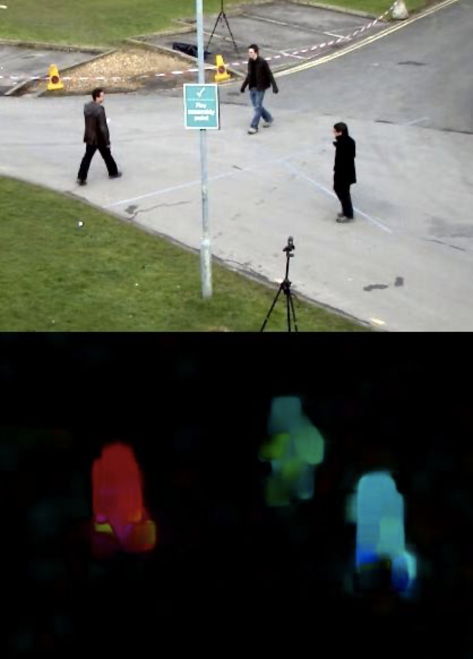
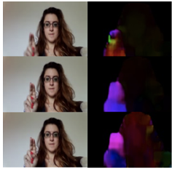
2. Background knowledge
Optical flow
It is the pattern of apparent motion of image objects between two consecutive frames due to the movement of object or camera.
The dense optical flow could help us detect the movement parts of the video.

Slide 10
3. Short-Term Sampling Neural Networks
Motivation:
Design a model better than 3D-CNN
Reduce the model training computation
Improve model accuracy

Slide 11
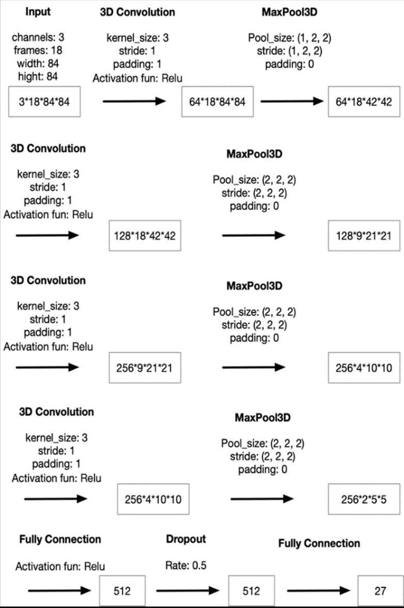
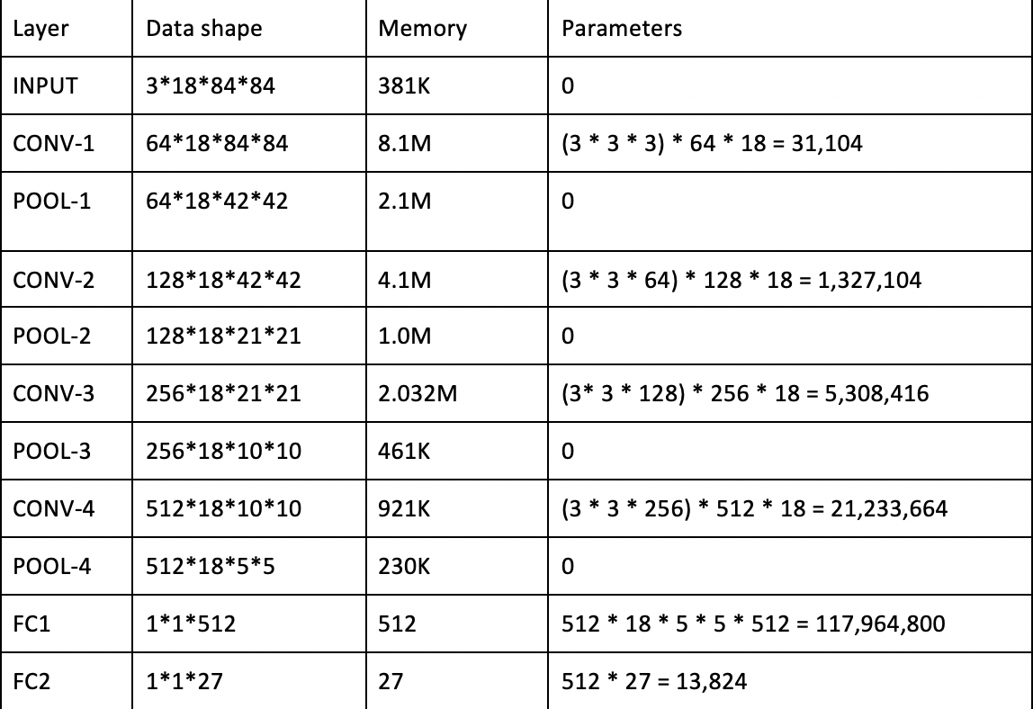
3. Short-Term Sampling Neural Networks
3D-CNN architecture for hand gesture recognition training parameters of 3D-CNN model
It cost about 80MB memory for each video(forwarding process)
It should train about 146M parameters.

Slide 12
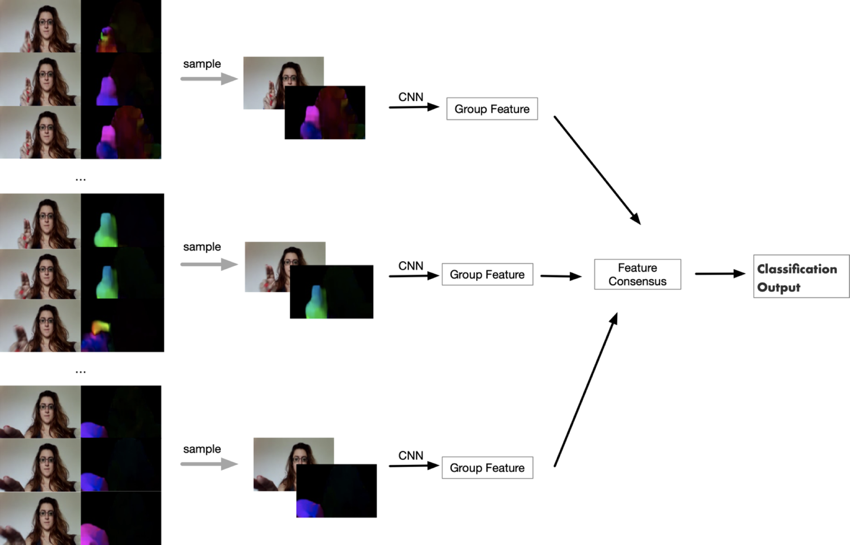
3. Short-Term Sampling Neural Networks
A variant of two stream idea
Reduce the input by group sampling because the content changes relatively slowly
A CNN architecture used to fetch the feature
Feature consensus use fully connected layer to fuse the result
The group number affects the model accuracy
Notes:
Fewer groups could reduce the computation cost but it also reduces the accuracy of the model. On the contrary, more groups could increase the computation cost and meanwhile the accuracy of the model increase as well.

Slide 13
3. Short-Term Sampling Neural Networks
In this study, we choose the Inception V2 pre-trained model as the CNN architecture to increase the training performance.
The Inception V2 not only has a great balance between efficiency and accuracy but also the batch normalization could reduce the over-fitting problem.
Inception V2 pre-trained model was trained in ImageNet which contains 1.2 million train samples.
To avoid the overfitting problem, a dropout layer is added after pooling layer and the dropout radio is 0.5

Slide 14
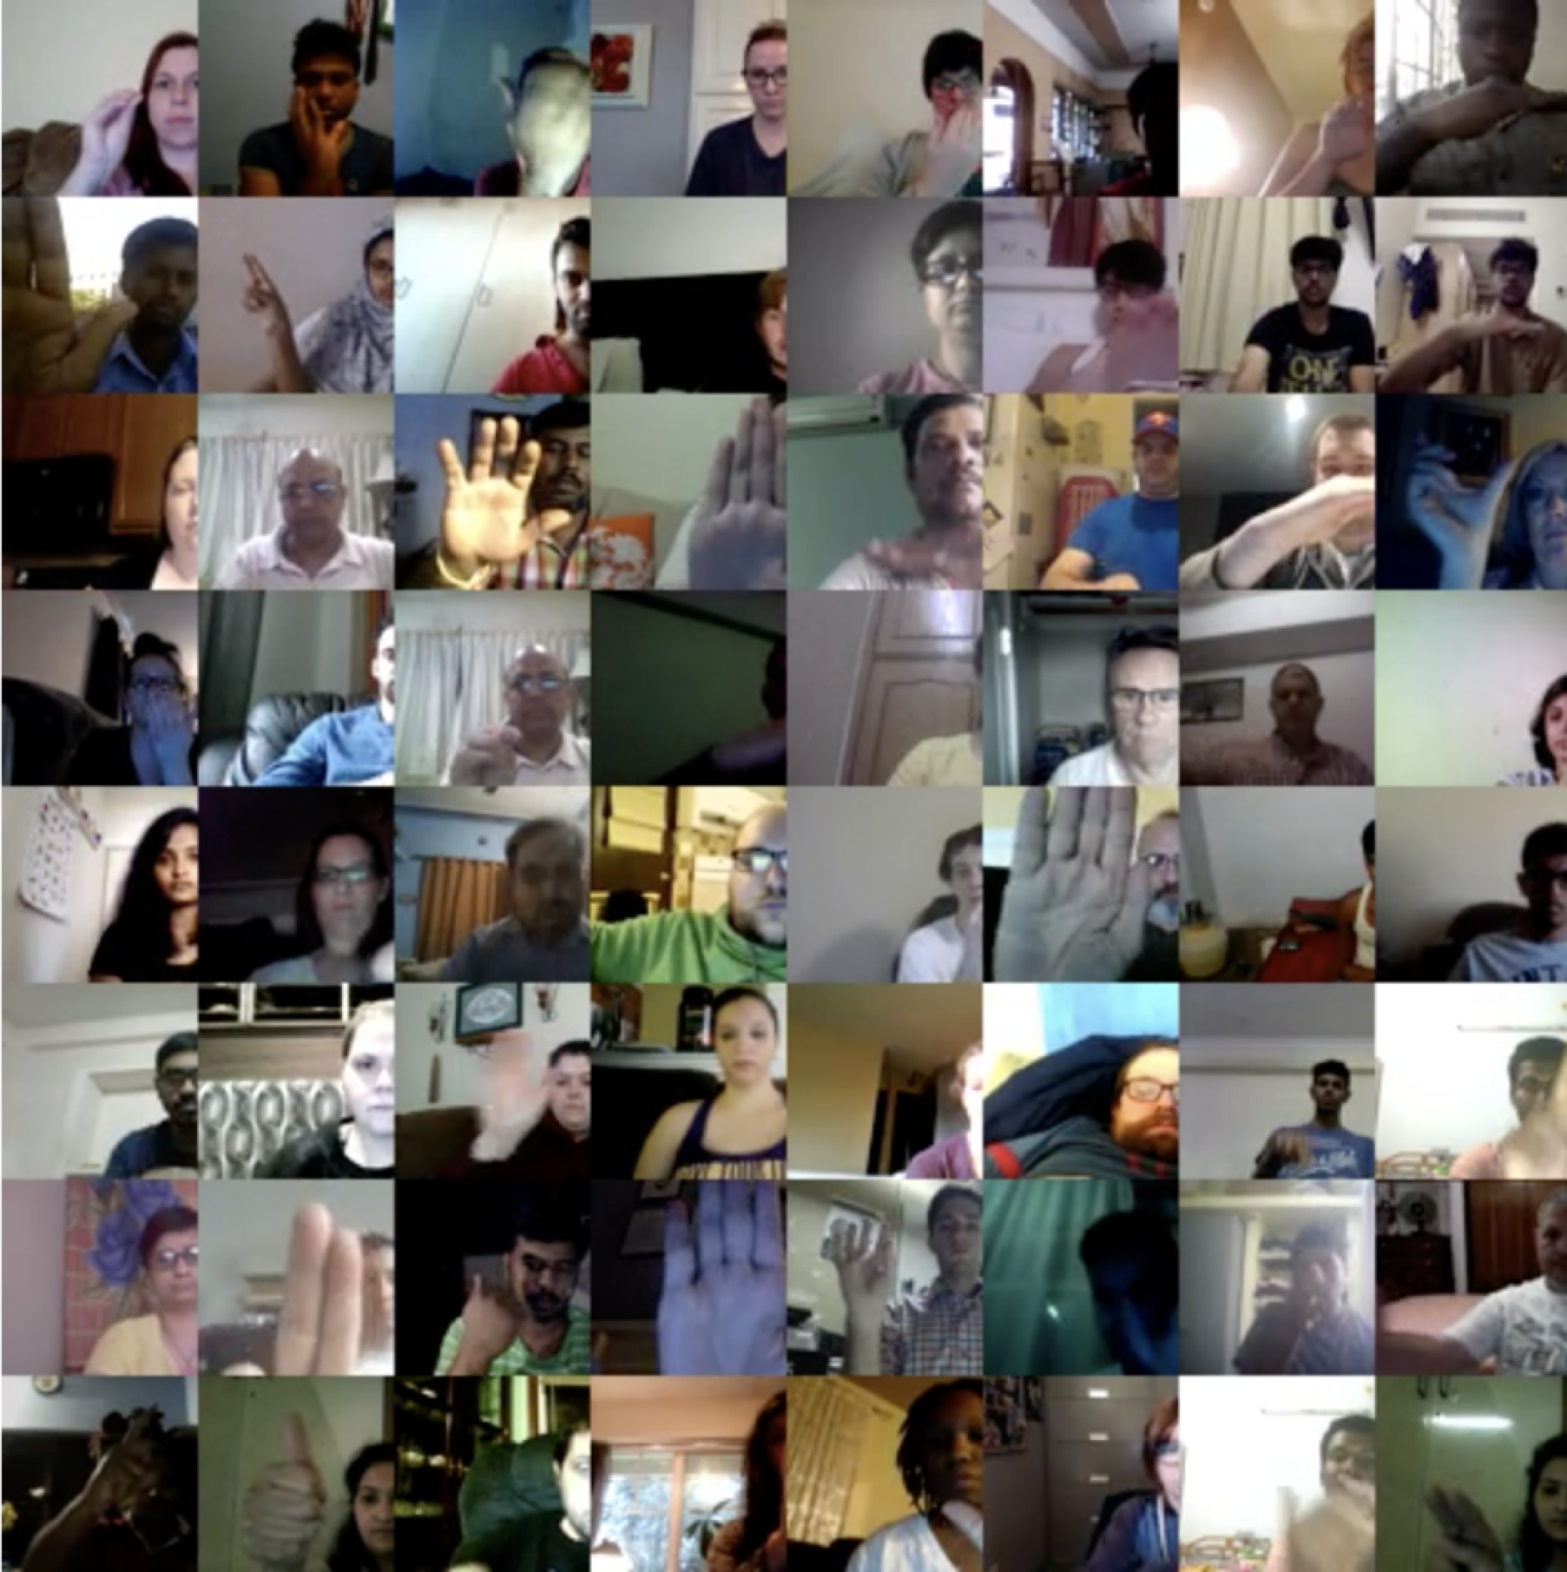
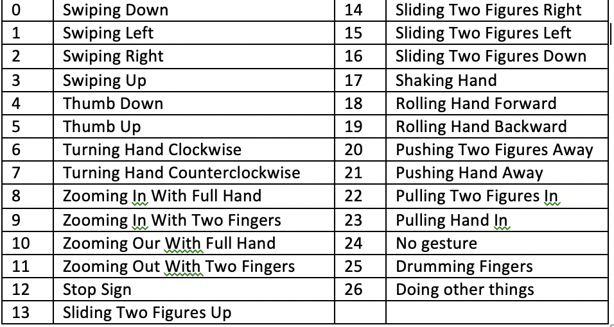
4. Experiment
Jester Dataset
This dataset collected and organized by Twenty BN.
This dataset contains 27 types hand gestures. Among them, how to classify the two figures and the whole hand is the challenging.
There are 148,092 videos in this dataset: 118,562 for training, 14,787 for validation and 14,743 for testing

Slide 15
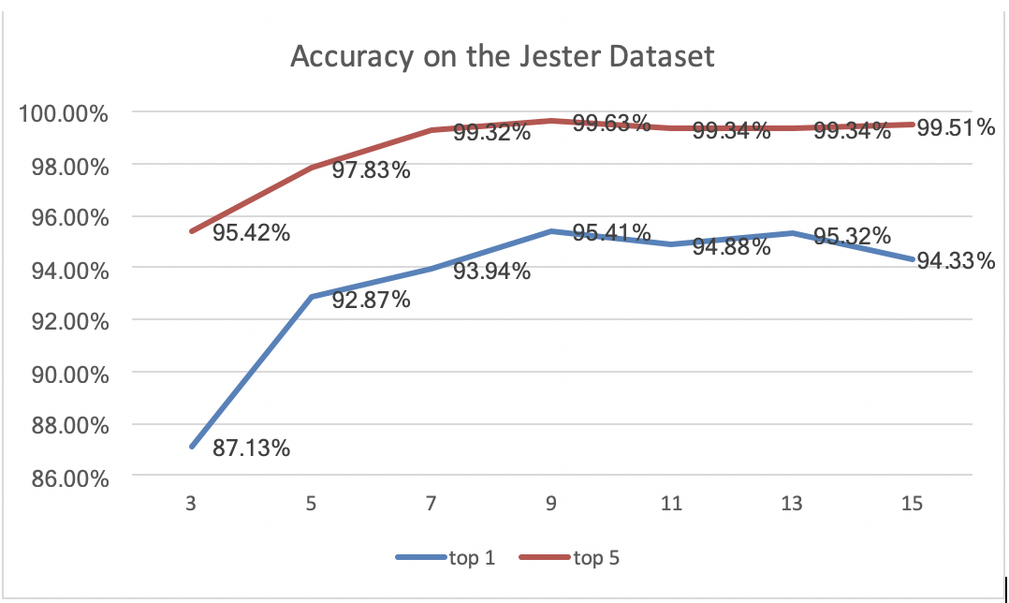
4. Experiment
Experiment on Jester Dataset
Goal: to find suitable group number and check the model performance;

Slide 16
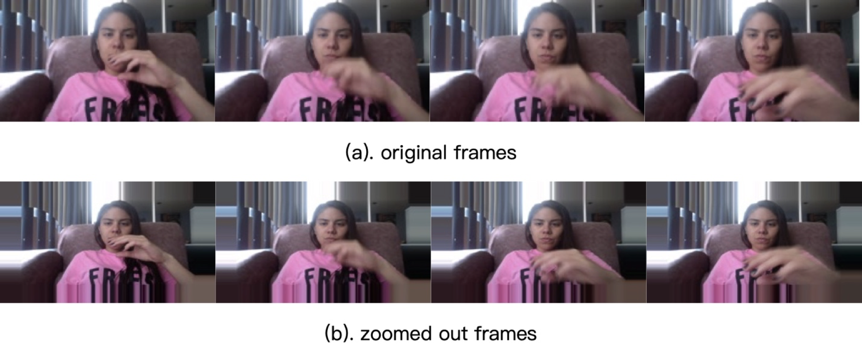
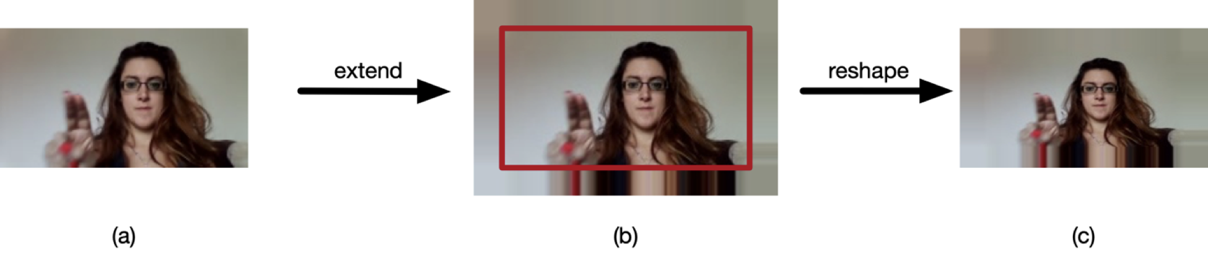
4. Experiment
Experiment on “Zoomed-out” dataset
Goal: to test the robustness of this new network;
Propose an new approach to “Zoom out” the video in the dataset.

Slide 17
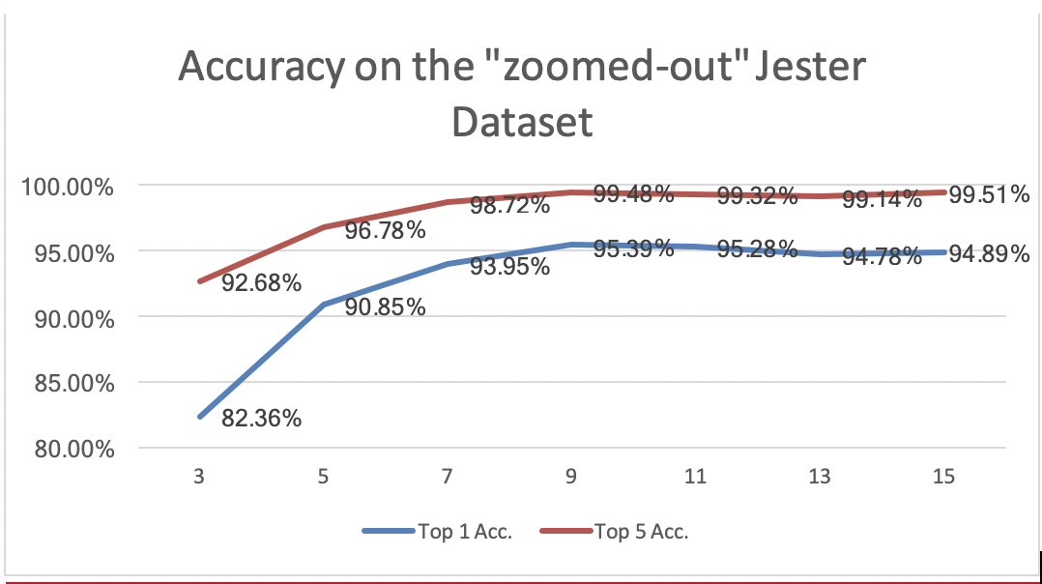
4. Experiment
Experiment on “Zoomed-out” dataset

Slide 18
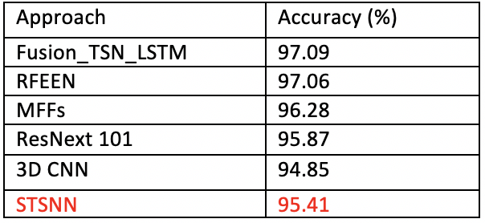
4. Experiment
Comparison with other approaches
Notes:
Comparing with other approaches, our approach, STSNN, achieves a relatively good result with 95.41%

Slide 19
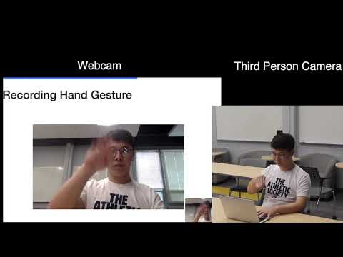
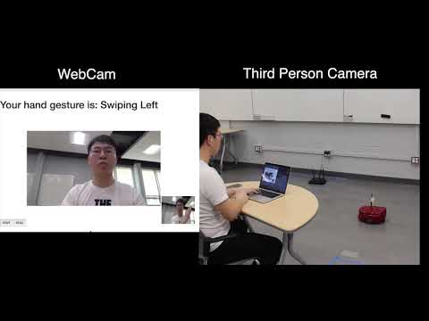
4. Experiment
System Testing

Slide 20
5. Conclusion
propose a new short-term sampling neural network for hand gesture recognition
The advantages of this new method:
1. It reduced the input number of video frames by using group sampling
2. It reduced the training parameters by sharing CNN parameters.
3. It fixed the model input regardless of video length.
zoom out the Jester dataset to test the robustness of STSNN.

Slide 21
5. Conclusion
Future work
Applying STSNN to some other challenging video analysis tasks
Using the deep learning method to calculate the optical flow picture
Trying to using STSNN to handle untrimmed hand gesture video.

